Slide 1






Working Group Meeting # 1b
Methodology for DSIP – Urban Wastewater Treatment Directive (UWWTD)
29 April 2022
Result 2: Directive Specific Implementation Plan
CONSULTANT CONSORTIUM
SETEC ENGINEERING & SWECO

Slide 2
Agenda of WG meeting
Opening and Introduction
Presentation of Methodology
Work Plan for preparation of the DSIP
Coffee Brake
Discussion of proposed methodology
Wrap-up and next steps
2

Slide 3
Presentation of methodology for DSIP
Introduction
Requirements of the UWWTD
DSIP Table of Content
Present Situation of legal and institutional framework
Current status of wastewater Infrastructure
Gap Analysis and Implementation Measures
Investment Cost Estimate
Implementation timeframe
3

Slide 4
Introduction
Purpose of the working group:
Designing a DSIP for the Urban Waste Water Treatment Directive
  Links
    AMBU (Water Framework Directive)
    MARD (Sludge Directive)
    MTE (Environmental and Social Impact Assessment)
    institutional structures, staffing and budgets
    national policy for service delivery and cost recovery
4

Slide 5
Requirements of the UWWTD
The Urban Waste Water Treatment Directive (UWWTD)
Council Directive 91/271/EEC of 21 May 1991 concerning urban waste water treatment
Objective: The Directive is aimed at protecting the aquatic environment from the adverse effects of urban wastewater, such as eutrophication. It sets out EU-wide rules for collection, treatment and wastewater discharge. The Directive also covers wastewater generated by industries such as the agro-food industries (like food-processing and brewing).
5

Slide 6
Requirements of the UWWTD
Article 1 states clearly that the UWWTD
  concerns
    the collection, treatment and discharge of urban waste water and
    the treatment and discharge of waste water from certain industrial sectors
  is intended to protect the environment from the adverse effects of the above-mentioned waste water discharges

Slide 7
Requirements of the UWWTD
The definitions in Article 2 of the Directive (e.g. ‘agglomeration’) should always be interpreted from the perspective of protecting the environment (i.e. Article 1)
Everything in this DSIP needs ultimately to address the requirements of Article 1

Slide 8
Requirements of the UWWTD
Key obligations (most important articles)
Collect wastewater in urban settlements with more than 2,000 P.E. (Article 3)
Provide waste water treatment for all these agglomerations as follows:
  Apply secondary treatment to the collected wastewaters (Article 4);
  Apply more stringent treatment for agglomerations with over 10,000 P.E. in sensitive areas (Article 5);
8

Slide 9
DSIP Table of Content
1. Executive Summary
2. Introduction
3. Present Situation
3.1 Sector Challenges
3.2 Legal and Policy Framework
3.3 Institutional Framework
3.4 Current status of Wastewater Infrastructure Implementation
4. Gap Analysis and Implementation Measures
4.1 Gaps and measures for Wastewater Infrastructure
4.2 Legal and policy gaps and Measures
4.3 Institutional gaps and Measures
5. Investment Cost Estimate
5.1 Wastewater Infrastructure Investments
5.2 Legal and policy measures
5.3 Institutional measures
5.4 Summary and conclusions
6. Implementation timeframe and transition period
6.1 Prioritisation of Measures
6.2 Implementation Plan
7. Annexes
9

Slide 10
Present legal and policy framework
Methodology | Tentative Output
To provide an overview of the Albanian water legal and policy framework, including existing draft, and other relevant related legislation, taking into account the findings of the Legal Gap Analysis report (Result 5) | Albanian Legal Framework transposing the UWWTD and SSD (primary legislation / legal basis and secondary legislation) EU legal framework, relevant to the implementation of the UWWTD and SSD and the related Albanian regulatory framework Detailed assessment of the Albanian legal framework transposing the UWWTD and SSD, and current level of implementation.
Legal framework transposing UWWTD: Law no.9115, dated 24.07.2003 ‘On Environmental Treatment of Waste Water’; Law no.111, dated 15.12.2012 ‘On Integrated Water Resources Management’; Law no.10463, dated 22.09.2011 ‘On Integrated Waste Management’; Law no.8102, dated 28.03.1996 ‘On regulatory framework of water supply, sewage and waste water treatment’, as amended; Law no. 119/2014 ‘On the Right to Information;
10

Slide 11
Present legal and policy framework(2)
Legal framework transposing UWWTD: DCM no.958, dated 06.05.2009 ‘On approval of licensing categories and licensing application procedures concerning operators working in Water Supply Systems, Sewage and Waste Water Treatment’; DCM no.1304 of 11.12.2009 ‘On approval of regulation model on Water Supply System and Sewage in Service Area of WSC’; DMC no.247, dated 30.04.2014 ‘Rules for public information and involvement in the environmental decision-making procedure’; DCM no.63, dated 27.01.2016 ‘For reorganization of operators that provide water supply, collection, disposal and wastewater treatment services’; Decision of the National Water Council no.2/2015 “On treatment of urban waste water” pursuant to article 73, 74, 76 and 77 of law no.111/2012 DCM no.27, dated 11.02.2015 ‘On requirements on reuse of waste water sludge in agriculture’; DCM no.431, dated 11.07.2018 ‘On creating, organizing and operating of National Agency of Water Supply, Sewage and Waste Infrastructure’. DCM No. 1015, date 16.12.2020 on the Content, Development and Implementation of National Water Strategies, of River Basin District Management Plans and Flood Risk Management Plans.
11

Slide 12
Present legal and policy framework
EU legal framework | AL context
Directive 2000/60/EC | Law no. 111/2012 on “Integrated water resources management’’,
Nitrate Directive 91/676/EEC | Law No.111/2012
Marine strategy framework directive | Law no. 8905/2002 ‘On protection of marine environment from pollution and damage’, as amended Law no. 111/2012, Article 1(1) “purpose”, Art. 2(2a)“Scope”
Bathing water directive | Law no. 7643, no.02.02.1992 ‘On sanitary inspection’ DCM no. 797/2010 ‘On the approval of the Hygienic-Sanitary Regulation on Bathing Water Quality Administration’
Directive 2007/60/EC on Floods | Law 111/2012, Article 70
Directive 2008/98/EC on waste (Waste Framework Directive | Law no.10463/2011 ‘On integrated waste management’, DCM no.99/2005 ‘On the adoption of the Albanian catalogue of waste classification’ (as amended)….
12

Slide 13
Present institutional framework
Methodology | Tentative Output
To provide an overview of the Albanian water institutional framework at central and local level, taking into account the findings of the Legal Gap Analysis report (Result 5), analysis the functions needed to implement the UWWTD and SSD: Regulatory Planning, Regulation including permitting, Monitoring, Information and reporting, Enforcement, Service Provision, Investment planning and sector sponsorship. | Description of the entities involved in the implementation of the UWWTD and SSD Functional analysis of the institutional framework and its capacity to implement the UWWTD and SSD provisions
13

Slide 14
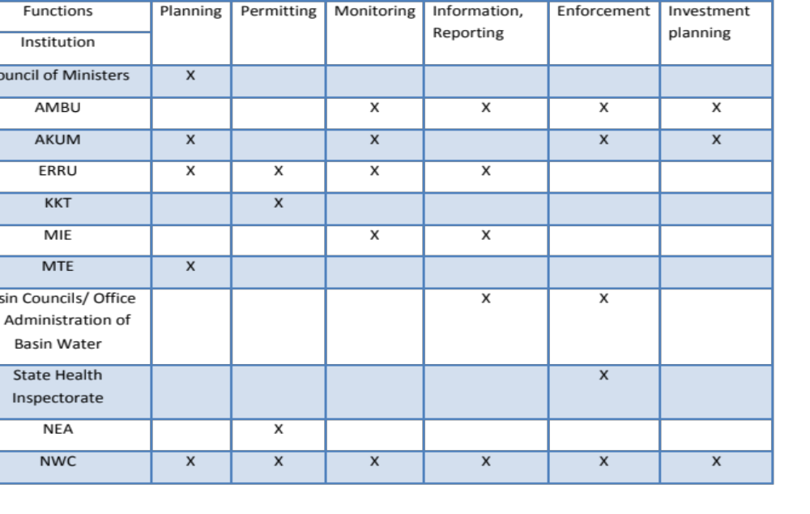
Present institutional framework
14

Slide 15
Current status of Wastewater Infrastructure
Delineation of Agglomerations
Delineation of sensitive areas
Status of wastewater collection infrastructure
Status of wastewater treatment infrastructure
15
Notes:
The chapter 3.4. Current status of Water Supply Infrastructure Implementation
Will include subchapters for delination of WSZs, ………..

Slide 16
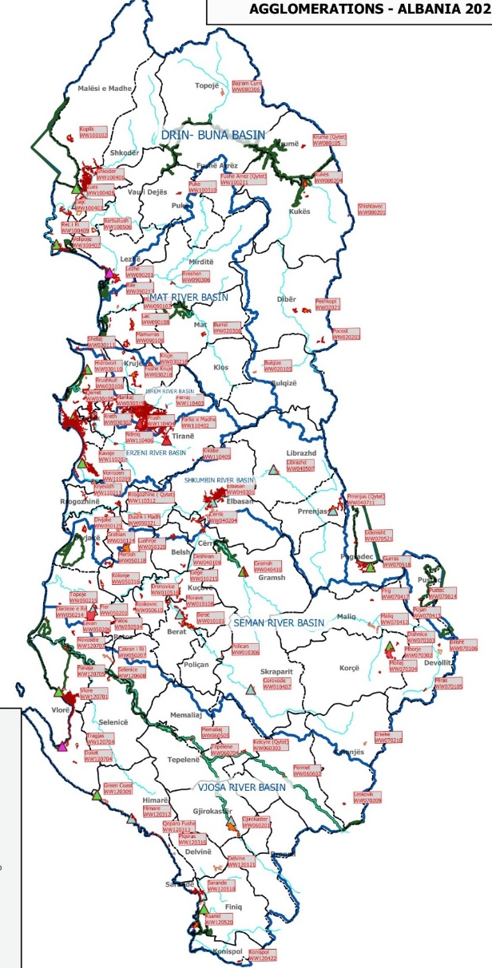
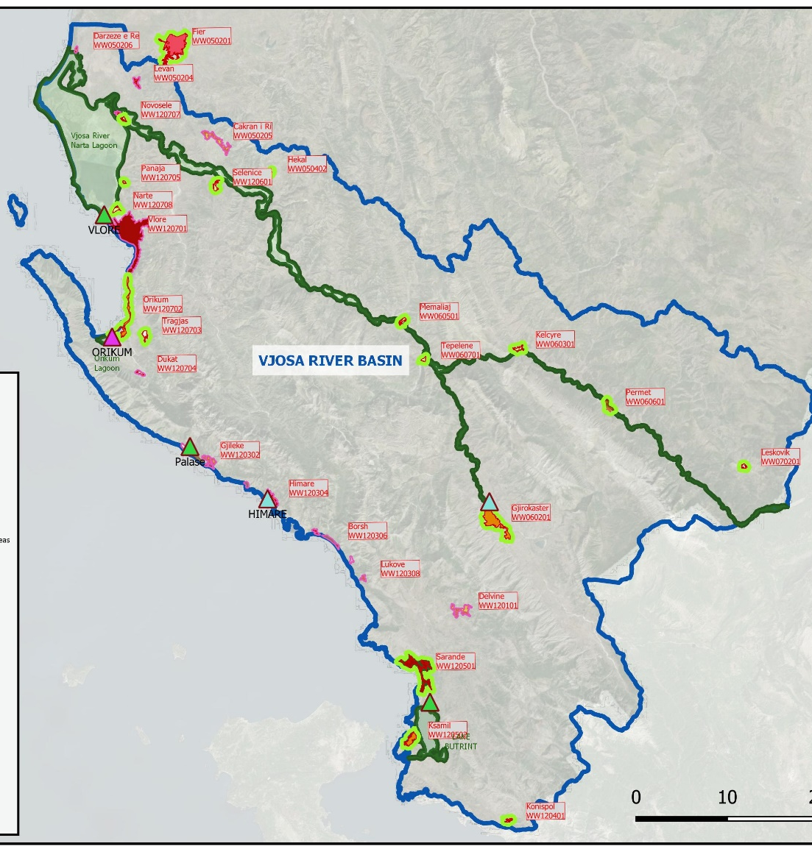
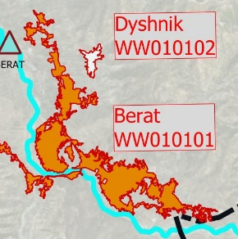
Delineation of Agglomerations
16
Notes:
a) Source of Information:
Water negotiations and investment planning support, Task 1 Report Vol. 1 (submitted 12/2021)
b) Methodology
Methodology for delineation of Agglomerations is described in Task 1 Report
In this chapter a short summary of Task 1 Report will be presented.
c) Tentative Output
In total 165 agglomerations have been identified, in which about two thirds of the population (2.1 million) in Albania are currently living.

Slide 17
Delineation of Agglomerations
Waste water load generated by category of agglomeration size
Category of agglomeration size | Number of agglomerations |  | Total WW load generated 2020 | Total WW load generated 2050 | Maximum WW load generated (2020-2050) |  | Agglomerations in sensitve areas
Max P.E. | # | % | PE60 | PE60 | PE60 | % | number | %
below 1,000 | 6 | 4% | 4,050 | 3,062 | 4,050 | 0% | 6 | 100%
1,001- 2,000 | 31 | 19% | 46,248 | 37,521 | 46,684 | 1% | 19 | 61%
2,001- 5,000 | 67 | 41% | 199,147 | 169,628 | 204,204 | 5% | 47 | 70%
5,001-10,000 | 27 | 16% | 166,086 | 150,548 | 175,333 | 5% | 15 | 56%
10,001-50,000 | 21 | 13% | 390,959 | 341,735 | 403,745 | 10% | 15 | 71%
50,001-100,000 | 5 | 3% | 365,030 | 382,367 | 398,661 | 10% | 4 | 80%
above 100,000 | 8 | 5% | 2,297,692 | 2,625,423 | 2,660,126 | 68% | 5 | 63%
Total | 165 | 100% | 3,469,211 | 3,710,284 | 3,892,803 | 100% | 111 | 67%
^{[1]}
17
Notes:
The total generated waste water load of about 3.5 million P.E. in 2020 is projected to increase to 3.7 million P.E. in 2050.
The waste water load by category of load size (in P.E.) is presented in the table below and summarized as follows:
Eight (8) agglomerations (5 %) have a maximum load in the projection period above 100,000 P.E. (Tirane, Durres, Vlore, Kavaje, Shkoder, Sarande, Elbasan and Velipoje), with a total load of 2.6 million P.E., corresponding to 68 % of the total waste water load in the country.
In the next category between 10,000 and 100,000 P.E. there are 26 agglomerations (16 %) generating a load of about 0.8 million P.E. (20 % of total load).
In the category between 2,000 and 10,000 P.E. there are 94 agglomerations (57 %) generating a load of about 0.38 million P.E. (10 %).
Finally, in the category below 2,000 P.E. there are 37 agglomerations (23 %) generating a load of about 0.05 million P.E. (1 %).

Slide 18
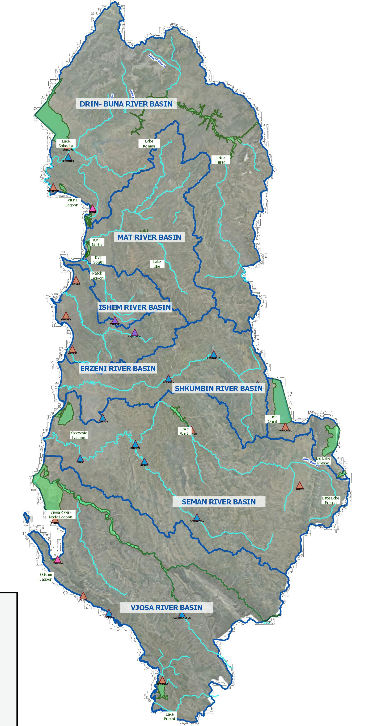
Delineation of Sensitive Areas
Sensitive Area No and Name
SA01 Lake Fierza
SA 02 Lake Koman
SA 03 Kune Vain Tale North
SA 04 Lake Shkodra
SA 05 Buna Mouth/ Viluni Lagoon
SA 06 Lake Ohrid
SA 07 Big Lake Prespa
SA 08 Little Lake Prespa
SA 09 Lake Ulëz
SA10 Kune Vain Tale South
SA11 Patok
SA11 Patok
SA11 Patok
SA12 Bish Kamez Rrushkull
SA13 Karavasta Lagoon
SA13 Karavasta Lagoon
SA14 Belsh Lakes
SA15 Lake Banja
SA16 Vjosa River Narta Lagoon
SA17 Orikum Lagoon
SA18 Lake Butrint
18
Notes:
b) Methodology
The approach and methodology for delineation of Sensitive Areas is described in Task 1 Report, Vol. 2
In this chapter a short summary of Task 1 Report Vol. 2 will be presented.
Under the UWWTD, two approaches can be taken concerning identification of discharges that require more stringent treatment:
Individual sensitive areas (or catchments of sensitive areas) that can be identified (Article 5.1) within Albania OR
More stringent treatment can be provided throughout the territory (Article 5.8).
c) Tentative Output
A total of eighteen sensitive areas have been demarcated within the seven main river basins in Albania in accordance with UWWTD criteria.
111 agglomerations (67%) are generating waste water which are discharging to sensitive areas out of which 24 agglomerations (15 % of all agglomerations) above 10,000 P.E. would be subject to more stringent treatment requirements => tertiary treatment.
Albania therefore needs to decide on whether to follow Article 5(5) of the UWWTD and the identification of individual sensitive areas as shown above, or to apply the provisions of Article 5(8), i.e. more stringent treatment for the entire country.

Slide 19
Status of wastewater collection infrastructure
Current wastewater connection rates and length of sewer network are available from AKUM Benchmarking Data at utility level.
The existence of sewer networks in rural areas => from ADA, USAID reports
Condition assessment (e.g. age of network) from master plan, 2013 + update from Feasibility Studies.
For rural areas no data exist on condition => assumption
Condition categories will be prepared for each agglomeration (very good to very bad) => assumptions for data gaps
19
Notes:
b) Methodology
Current wastewater connection rates and length of sewer network are available from AKUM Benchmarking Data for the service area of each water utility (connection rate is separated in urban and rural areas).
The existence of sewer networks in rural areas derived from studies carried out for areas „out of Jurisdiction“ in 2017 (ADA) and 2016 (USAID). Additionally, other sources were considered including feasibility studies (see Task 1 Report, Vol. 1, Annex 9). A breakdown by agglomerations has been prepared in the Task 1 Report Vol. 1.
The condition of wastewater collection infrastructure in rural areas will be assessed based on data collected by ADA, 2017 and USAID, 2016 based on the age of infrastructure and condition rating as far as available.
For urban areas the condition of assets will be derived from „Water Supply and Sewerage Master Plan for Albania, 2013, Master Plan Appendix 1: Brief Description of Water Utilities / Inventory“.
It is noted that condition assessment in rural areas conducted in 2016 and 2017 does not cover all villages, but as the number of existing sewer networks in rural areas is very limited, assumptions for missing data can be made.
It is also noted that for urban areas the data on infrastructure condition presented in the Master Plan 2013, have not been updated in the Master Plan, 2019. We will therefore use condition assessment from 2013 and update the information based sewer measures implemented between 2013 and 2021.
Based on available data from the sources mentioned above, the Consultant will define condition categories for sewer networks for each agglomeration. The average age of sewer network in each agglomeration will be the key criteria. As far as available, benchmarking data (number of sewer blockages / km of network) will be taken into consideration. For agglomerations without any data on sewer condition, we will make assumptions on condition and replacement needs based on data from other agglomerations (e.g. average age at national level or regional level).
c) Tentative Output
This report section will include inter alia the following information on the current status of sewer network:
Current sewer connection rate and number of population connected.
Length of existing sewer network
Type of sewer network (combined or separate system)
Sewer length per household connected
Average age (or year of construction) of sewer network
Condition categories of sewer network (based on analysis of all data and assumptions made by the Consultant)
Statistics on sewer network data (aggregated data at national, regional, service area level)
Summary of key constraints (qualititative and quantitative analysis of condition)

Slide 20
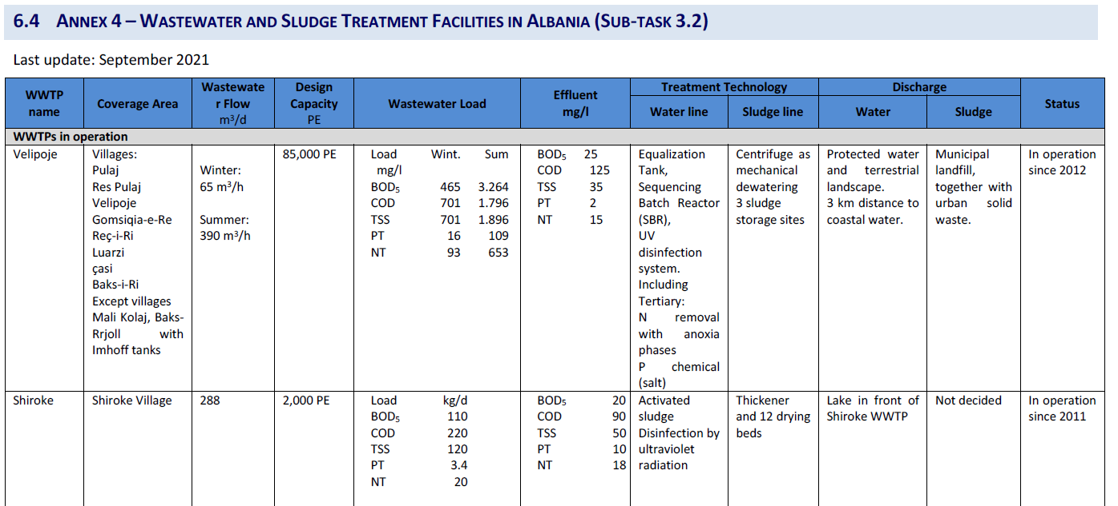
Status of wastewater treatment infrastructure
Sludge Management Strategy Preliminary Assessment (1 October 2021)
20
Notes:
Sludge Management Strategy Preliminary Assessment (1 October 2021)
Additional site visit for a few WWTP but no extensive field assesment is planned

Slide 21
  GAP Analysis and Implementation Measures
  Gaps and measures for Wastewater Infrastructure
    Waste Water Collection
    Waste Water Treatment
  Legal and policy gaps and Measures
  Institutional gaps and Measures
21

Slide 22
  Gaps and measures – Wastewater Collection
1) Extension of WW Network
WW Connection targets adjusted to WW treatment targets
Existing connection rates from AKUM Benchmarking data
Gap for each municipality calculated => additional number of population to be connected.
Meter of sewer network per capita depending on density in municipality
Result: Measures to reach full compliance with UWWTD
  Increase of connection rate and additional population equivalent connected to the sewer network
  Extension of sewer network, including pumping stations
22
Notes:
b) Methodology
Extension/new collection systems:
Projection for wastewater collection targets will be adjusted to compliance date for wastewater treatment. It is noted that compliance will be achieved if 95 % of the population is connected to a sewer network (for the remaining population connection to individual appropriate systems is assumed).
The gap between target wastewater connection rate and current connection rate will be calculated for each agglomeration.
The length of sewer network needed to close the gap will be estimated based on the population density in different categories of agglomeration (i.e. meter of sewer network per capita).
Rehabilitation of collection system:
Categorize condition of network based on age and KPIs from AKUM Benchmarking (number of sewer blockages) for each agglomeration.
For each condition category apply share of network length to be rehabilitated in a certain period (short-term, medium-term, long-term). For determining this share, available feasibility studies and CCTV inspections will be taken into consideration.
Supersede investment measures calculated
Compare investment needs calculated above with investment needs from detailed studies if available (e.g. Feasibility Studies and detailed designs).
Compare investment needs estimated in the National Master Plan for Water Supply and Sewerage in Albania, 2013. It is noted that the investment measures proposed in the master plan cannot be applied directly due to the fact that project areas and target connection rates were different compared to assumptions made in this DSIP.
c) Tentative Output
This report section will include inter alia the following gaps to reach compliance with the UWWTD, related to sewer network infrastructure for each agglomeration:
Increase of connection rate and additional population equivalent connected to the sewer network
Extension of sewer network, including pumping stations
length of sewer network to be rehabilitated and/or replaced.

Slide 23
  Gaps and measures – Wastewater Collection
2) Rehabilitation of WW Network
Categorize condition of network based on age and KPIs from AKUM Benchmarking (number of sewer blockages) for each agglomeration
Assumptions will made for data gaps (age of network not available)
For each condition category apply share of network length to be rehabilitated in a certain period (short-term, medium-term, long-term).
Feasibility Studies (e.g. CCTV inspection) will be considered
Result => length of sewer network to be rehabilitated and/or replaced.
23
Notes:
b) Methodology
Extension/new collection systems:
Projection for wastewater collection targets will be adjusted to compliance date for wastewater treatment. It is noted that compliance will be achieved if 95 % of the population is connected to a sewer network (for the remaining population connection to individual appropriate systems is assumed).
The gap between target wastewater connection rate and current connection rate will be calculated for each agglomeration.
The length of sewer network needed to close the gap will be estimated based on the population density in different categories of agglomeration (i.e. meter of sewer network per capita).
Rehabilitation of collection system:
Categorize condition of network based on age and KPIs from AKUM Benchmarking (number of sewer blockages) for each agglomeration.
For each condition category apply share of network length to be rehabilitated in a certain period (short-term, medium-term, long-term). For determining this share, available feasibility studies and CCTV inspections will be taken into consideration.
Supersede investment measures calculated
Compare investment needs calculated above with investment needs from detailed studies if available (e.g. Feasibility Studies and detailed designs).
Compare investment needs estimated in the National Master Plan for Water Supply and Sewerage in Albania, 2013. It is noted that the investment measures proposed in the master plan cannot be applied directly due to the fact that project areas and target connection rates were different compared to assumptions made in this DSIP.
c) Tentative Output
This report section will include inter alia the following gaps to reach compliance with the UWWTD, related to sewer network infrastructure for each agglomeration:
Increase of connection rate and additional population equivalent connected to the sewer network
Extension of sewer network, including pumping stations
length of sewer network to be rehabilitated and/or replaced.

Slide 24
  Gaps and measures – Waste Water Treatment
1) Estimation of required facilities
165 Agglomerations from Waste Water Agglomerations and Water Supply Zones Report (23 December 2021)
Life cost optimization analysis for wastewater transport and treatment based on CAPEX and OPEX for WWTPs and collectors for Centralized and Decentralized approach
Estimated 113 WWTPs in Clustering options for wastewater treatment - Draft Working Document (30 March 2022)
24
Notes:
b) Methodology
Extension/new collection systems:
Projection for wastewater collection targets will be adjusted to compliance date for wastewater treatment. It is noted that compliance will be achieved if 95 % of the population is connected to a sewer network (for the remaining population connection to individual appropriate systems is assumed).
The gap between target wastewater connection rate and current connection rate will be calculated for each agglomeration.
The length of sewer network needed to close the gap will be estimated based on the population density in different categories of agglomeration (i.e. meter of sewer network per capita).
Rehabilitation of collection system:
Categorize condition of network based on age and KPIs from AKUM Benchmarking (number of sewer blockages) for each agglomeration.
For each condition category apply share of network length to be rehabilitated in a certain period (short-term, medium-term, long-term). For determining this share, available feasibility studies and CCTV inspections will be taken into consideration.
Supersede investment measures calculated
Compare investment needs calculated above with investment needs from detailed studies if available (e.g. Feasibility Studies and detailed designs).
Compare investment needs estimated in the National Master Plan for Water Supply and Sewerage in Albania, 2013. It is noted that the investment measures proposed in the master plan cannot be applied directly due to the fact that project areas and target connection rates were different compared to assumptions made in this DSIP.
c) Tentative Output
This report section will include inter alia the following gaps to reach compliance with the UWWTD, related to sewer network infrastructure for each agglomeration:
Increase of connection rate and additional population equivalent connected to the sewer network
Extension of sewer network, including pumping stations
length of sewer network to be rehabilitated and/or replaced.

Slide 25
  Gaps and measures – Waste Water Treatment
2) Identification of gaps
Sixteen of required WWTPs are already existing or under construction and will require further ad-hoc analysis to asses rehabilitation, upgrade, extension and replacement works
97 WWTPs new facilities (including collectors)
Comparison with Feasibility Studies where available
Integration with Sludge Management Strategy requirements
25
Notes:
b) Methodology
Extension/new collection systems:
Projection for wastewater collection targets will be adjusted to compliance date for wastewater treatment. It is noted that compliance will be achieved if 95 % of the population is connected to a sewer network (for the remaining population connection to individual appropriate systems is assumed).
The gap between target wastewater connection rate and current connection rate will be calculated for each agglomeration.
The length of sewer network needed to close the gap will be estimated based on the population density in different categories of agglomeration (i.e. meter of sewer network per capita).
Rehabilitation of collection system:
Categorize condition of network based on age and KPIs from AKUM Benchmarking (number of sewer blockages) for each agglomeration.
For each condition category apply share of network length to be rehabilitated in a certain period (short-term, medium-term, long-term). For determining this share, available feasibility studies and CCTV inspections will be taken into consideration.
Supersede investment measures calculated
Compare investment needs calculated above with investment needs from detailed studies if available (e.g. Feasibility Studies and detailed designs).
Compare investment needs estimated in the National Master Plan for Water Supply and Sewerage in Albania, 2013. It is noted that the investment measures proposed in the master plan cannot be applied directly due to the fact that project areas and target connection rates were different compared to assumptions made in this DSIP.
c) Tentative Output
This report section will include inter alia the following gaps to reach compliance with the UWWTD, related to sewer network infrastructure for each agglomeration:
Increase of connection rate and additional population equivalent connected to the sewer network
Extension of sewer network, including pumping stations
length of sewer network to be rehabilitated and/or replaced.

Slide 26
  Legal and policy gaps and Measures
  Actions required to complete transposition and consolidate the legal framework: adopting primary and secondary legislation
  Actions required to complete the policy framework besides the specific requirements of the directive.
  Table of Concordance (ToC)
N° | Article of EU Directive and requirement | Responsible Organisation | Gaps | Actions | Timeline
 | To be completed | To be completed | To be completed | To be completed | To be completed
 | To be completed | To be completed | To be completed | To be completed | To be completed
 | To be completed | To be completed | To be completed | To be completed | To be completed
 | To be completed | To be completed | To be completed | To be completed | To be completed
26
Notes:
b) Methodology
Based on the findings of the legal assessment report, integrated with the outcomes of the most updated and in depth analysis of the sector, the DSIPs will identify for each obligation prescribed by the DWD:
The corresponding Albanian legal provision(s) if any (including drafts)
The Status of transposition
Existing gaps (amendments needed to the existing primary and secondary legislation, missing primary and secondary pieces of legislation, etc.)
Proposed measures to fill the gaps, including economic and financial aspects, and timeline for the following:
Actions required to complete transposition and consolidate the legal framework: adopting / amending / repealing primary and secondary legislation
Actions required to complete the policy framework besides the specific requirements of the directive.
c) Tentative Output
Analysis of policies relevant for the formulation and implementation of the DSIP, and related legal, institutional and financial requirements
Summary table describing the main gaps identified, the actions proposed and the timeline for implementation.
Table of Concordance (ToC) attached to this DSIP,
ToC is complemented with an additional table listing the primary and secondary legislation needed to complete the transposition and ensure the implementation of the UWWTD, SSD legislation
This report section will address, inter alia, the following legal gaps identified in the legal gap analysis report, to reach compliance with the UWWTD and SSD:
Urban waste water treatment
Regulatory Planning: Unclear definition of competences in the identification of sensitive areas. The role of the MTE and NAPA in the identification and definition of sensitive areas needs to be clarified. In general the Law 9115/2003, and related sub-legal acts, and the Law 111/2012 should be better streamlined.
Regulation and permitting: The technical regulation defining the design and construction of wastewater treatment plants is missing.
Monitoring: The institutional set up is not clear. The competences related to the water monitoring should be clarified. The draft water package, currently under discussion, includes provisions regulating the water monitoring WFD compliant.
Information and reporting: the system of reporting and informing the public is fragmented and not functioning regularly and in a transparent manner.
Investment planning: The legal basis for the adoption of technical and financial programme for the implementation of art. 17 of the UWWTD is missing.
Sewage sludge
Regulatory Planning: The current legislation does not prescribe the development of a dedicated strategy document on sludge (sludge strategy is currently not required by law)
Regulation and permitting: The DCM transposing the SSD does not define the limit values for chromium in sludge and soil
Monitoring: A monitoring system for soil is not in place
Information and reporting: Legislation has not been aligned to the Regulation (EU) 2019/1010 and to the INSPIRE directive requirements yet.

Slide 27
  Institutional gaps and Measures
  Identify for each obligation prescribed by the DWD
  Responsible body => Table of functions
  Existing gaps
  Proposed measures, including economic and financial aspects, and timeline
27
Notes:
b) Methodology
Based on the findings of the legal and institutional assessment report, integrated with the outcomes of the most recent analysis, the DSIPs will identify for each obligation prescribed by the DWD:
The body competent to implement and enforce the provision at national and local level (institutional and administrative set up, including sanctions and incentives for water re-use). The impact of on-going process of reorganization of water services will be also taken into account.
Existing gaps, overlaps and constraints.
Proposed measures, including economic and financial aspects, and timeline for the following required to complete implementation: Delineation of the institutional framework for each of the institutional functions (Regulatory planning, Regulation including permitting, Monitoring, Information and Reporting, Enforcement, Investment planning and Sector Sponsorship).
c) Tentative Output
Analysis of policies relevant for the formulation and implementation of the DSIP, and related institutional and financial requirements.
Summary table describing the EU obligations, the organization responsible for its implementation, the main gaps identified, the actions proposed and the timeline for implementation.
Table of functions will be attached to this DSIP.

Slide 28
  Investment Cost Estimate – Waste Water Collection Infrastructure
  Unit costs for water supply networks based on recent feasibility studies and tender documents in Albania
  Quantities estimated in Chapter 4
  Compared and complemented with Master Plan Cost estimates (2013, 2019) and Feasibility Studies
  Cost estimates will be provided at agglomeration level
  Extension and Rehabilitation of Infrastructure.
28
Notes:
b) Methodology
The cost assessment for sewer networks will be based on the following methodology:
Assess unit costs for sewer networks based on recent feasibility studies and tender documents in Albania and in the region.
Based on updated unit costs (e.g. for different diameters of networks), assumptions for the relation between size of an agglomeration (population equivalent) and aggregated unit costs for a respective agglomeration size (i.e. unit costs based on average network diameter). The unit cost will be based on assumptions of soil category, surface reinstatement, average depth of trenches, average diameter of pipes, etc. Further, unit costs for pumping stations and house connections will be assessed. Finally, unit costs for rehabilitation of sewer networks will be estimated based on recent studies in Albania and in the region.
The total investment costs for sewer network will be calculated based on (i) assessment of quantities in Chapter 3, (ii) unit costs described above and (iii) an allowance for contingencies and design and engineering.
The results of the cost estimates will be compared and if applicable superseded with investment costs from the Water Supply and Sewerage Master Plan 2013 and the updated master plan 2019. Further, for selected agglomerations the estimated costs will be compared with the cost estimates of the respective feasibility study.
c) Tentative Output
The output of this report section will include inter alia the following:
Unit cost tables and curves for different sizes and categories of agglomerations.
Table with investment cost estimates for each agglomeration broken down in extension and rehabilitation of sewer networks. The table will also include quantities (length of sewer network and investment costs per capita).
Summary table with statistics (aggregated by utility service area, region, river basins).

Slide 29
  Investment Cost Estimate – Waste Water Treatment Infrastructure
  From GAP analysis: WWTP location, WWTP size and selected technology, collector lengths and path and hydraulic sizing (flow, slope, diameter and need for pumping)
  Cost curves for new WWTPs, collectors and pumping stations
  Ad hoc estimate for the existing facilities and comparison with recent Feasibility Studies
  Re-investment costs
29
Notes:
b) Methodology
The cost assessment for main collectors and wastewater treatment facilities will be based on the methodology presented in the Clustering options for wastewater treatment - Draft Working Document (30 March 2022).
For the rehabilitation, upgrade, extension and replacement works required by the existing treatment facilities a specific methodology will be developed depend on the specific nature of such works.
c) Tentative Output
The output of this report section will include inter alia the following:
Unit cost tables and curves for different sizes and categories of WWTPs
Table with investment cost estimates for each agglomeration.
Summary tables with statistics (aggregated by utility service area, region, river basins)

Slide 30
  Cost Estimate Legal, Policy and Institutional Measures
  Estimation of the costs for legal and policy transposition and implementation => in coordination with other projects (EUSIWM, SANE27)
  Estimation of the costs for institutional reform measures
  Estimation of costs for capacity building measures for utilities and at national level
30
Notes:
Legal and Policy
b) Methodology
The same methodology described in Chapter 4.2 and 4.3 applies. Besides, the project team will liaise and coordinate with the EUSIWM project and SANE27 Programme, with reference to the development of the Regulatory Impact Analysis (RIA) of the new legal water package. An estimation of the costs for legal and policy transposition and implementation. The estimation will be developed in coordination with the other most relevant projects; in particular the EUSIWM project in preparing the Regulatory Impact Analysis (RIA) of the new legal water package, as well as with the programme SANE27.
The legal basis of the main sources of financing: tariff revenue (operational and maintenance costs, capital assets, etc.), external donors (EU, Sweden, other donors), government funds (central and local level, including abstraction/pollution charges, payment for environmental services, etc.).
c) Tentative Output
The output for this section will inter alia include:
Quantities for implementing the measures (person-months for consulting services, other costs)
Unit costs (€ / person-month)
Total costs
Timeline for implementing the measures (short-, medium-, long-term)
Responsible organisation for implementing the measures.
Institutional:
b) Methodology
Based on the measures identified in Chapter 4 above, the cost for implementing the measures will be roughly estimated. The following methodology will be applied:
Estimation of costs to ensure sufficient human capacity of the involved institutions to plan, implement and supervise investment projects/programmes at national level (e.g. Costs for Technical Assistance for capacity building)
Estimation costs to implement the institutional reform measures (e.g. aggregation of utilities’ service areas).
Estimated costs for improving the capacity of regulatory authorities (tariff regulation, environmental authorities, etc.).
Capacity building of PUCs in improving operational efficiency
c) Tentative Output
The output for this section will inter alia include:
Quantities for implementing the measures (person-months for consulting services, other costs)
Unit costs (€ / person-month)
Total costs
Timeline for implementing the measures (short-, medium-, long-term)
Responsible organisation for implementing the measures

Slide 31
  Implementation timeframe
  Prioritisation of measures
    Will be discussed in WG meeting # 3 in September
    Criteria will include inter alia:
    Size of agglomeration: Large agglomerations highest priority
    Project readiness: Design studies available
    Measures in touristic areas
31
Notes:
In general, the investment strategy should balance the investments on the one hand between water supply and wastewater and on the other hand between extension/new investments to ensure compliance and rehabilitation of existing assets to ensure sustainability.
For the wastewater subsector, the following criteria have been considered to assign the construction of wastewater collection and wastewater treatment including wastewater collectors within 4 planning horizons (2020, 2030, 2040, 2050): The following criteria are tentatively proposed to be applied (at a later stage the detailed prioritisation criteria will be discussed in a working group meeting):
WWTP currently constructed (either operational or not) and under construction/upgrade (inclusive of the collector to the respective agglomeration) have been assigned automatically to the 2020 slot.
Higher priority is given to large agglomerations/clusters, followed by Medium, and then Small and Very small.
WWTPs for which documentation (either feasibility studies or conceptual design) is already available have been assigned a higher priority.
Agglomerations with a touristic component have been assigned a higher priority. This criterion acknowledges that touristic input to the local economy may contribute to sustaining higher water tariffs as a result of an operational WWTP.
Wastewater collection measures should be completed at the same time or not more than some years before completion time of WWTPs to ensure full compliance of the agglomeration with requirements of the UWWTD (avoid discharging high concentrations of pollution load to the receiving waters without treatment, which would have an adverse impact on the environment. It is proposed that sewer networks should be extended to reach full compliance (95 % connection rate) in one project phase (avoid phased investments for sewer network), while staged investments in wastewater treatment plants might be eligible.
The tentative period when wastewater system can be expected to be in operation (compliance date) is presented in the table below.

Slide 32
  Implementation timeframe
  Prioritisation of measures
    Increase of service connections
    Rehabilitation of networks
    Wastewater collection measures should be completed at the same time or just before completion time of WWTPs.
    It is proposed that sewer networks should be extended to reach full compliance (95 % connection rate) in one project phase
32

Slide 33
  Implementation timeframe
  Implementation Timeframe
    Short term: 2030
    Medium term: 2031 to 2040
    Long term: 2041 to 2050
33

Slide 34
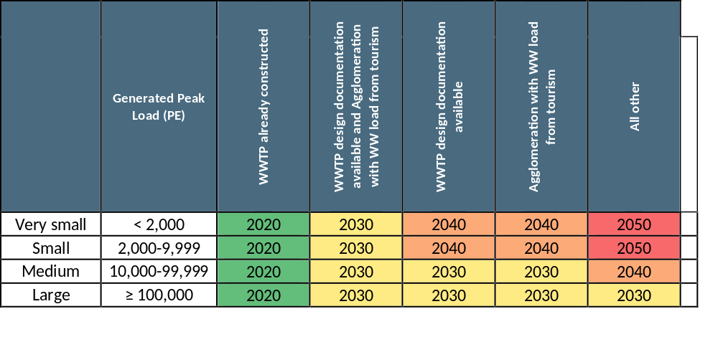
  Implementation timeframe

Slide 35
  DSIP Work Plan
Deliverable/Meeting | Date of Submission | Date WG Meeting
Chapter 3: Present Sitation | 23.6.2022 | 30.6.2022
Chapter 4: Draft Chapter 4: Gap Analysis and Implementation measures | 21.9.2022 | 28.9.2022
Draft Chapter 5: Investment Cost Estimate & Chapter 6: Implementation Timeframe | 3.11.2022 | 09.11.2022
Submit Compiled draft DISIPs for UWWTD and DWD (all chapters) | 30.11.2022 | 15.12.2022
Seminar 1: Presentation of Existing Situation |  | Proposed to be combined with WG meeting # 1
Seminar: Presentation of Draft report |  | 15.12.2022
35
Notes:
b) Methodology
The prioritisation of investment measures for water supply infrastructure will be based on the following methodology:
Draft prioritisation criteria will be presented to the Working Group meeting 3 (September 2022).
The overall objective and ultimate goal are to ensure compliance with all articles of the DWD. However, the investment amounts needed to achieve full compliance will be significant and measures will have to spread over 20 years (2030 – 2050).
In general, the investment strategy should balance the investments on the one hand between water supply and wastewater and on the other hand between extension/new investments to ensure compliance and rehabilitation of existing assets to ensure sustainability.
c) Tentative Output
For the water supply subsector, the following criteria will be considered to assign the investments of water supply infrastructure to the four planning horizons (2020, 2030, 2040, 2050):
Water Supply Infrastructure currently constructed (either operational or not) and under construction/upgrade will be assigned to the year 2020.
Water Supply Infrastructure measures with available feasibility and design studies and funding secured will be assigned to the year 2020.
Highest priority will be given measures in service areas with currently non-compliant water quality (inadequate water treatment, disinfection, sanitary protection zones), which will be assigned to the year 2030.
Second priority will be given to measures for Improvement of water quality monitoring (upgrade of laboratory facilities and drinking water monitoring in rural systems), which will be assigned to the year 2030.
Third priority will be given to areas with high touristic developments (in line with the criteria for wastewater collection and treatment), which will be assigned to the year 2030 – 2040.
Forth priority will be given to measures aiming to increase the service connection rate (target: 98 - 100 % connection). In particular priority will be given to expansion of water supply systems needed to ensure implementation of measures related to the UWWTD (connection rate for water supply has to be equal or higher compared to the target connection rate for wastewater services. Further, higher priority will be given to measures with lower per-capita investment costs. These measures will be assigned to the years 2040 – 2050.
Fifth priority will be given to measures for rehabilitation and replacement of existing networks and facilities (e.g. to reduce water losses or to reduce energy consumption).
Sixth priority will be given to other measures (e.g. efficiency improvement, operational performance improvement).

Slide 36

CONSULTANT CONSORTIUM
SETEC ENGINEERING & SWECO

